Slide 1

GOOGLE PLAY STORE ANALYSIS AND DATA VISUALIZATION
Under the supervision of – Dr. Sayantani Roy Choudhury
Prepared by :
Rishav Upadhaya.(A23033)
Soumyajit Biswas.(A23026)
Nikhil Kumar. (A23044)

Slide 2

Plan Of Talk
INTRODUCTION
LOADING AND UNDERSTANDING DATA
EXPLORATORY DATA ANALYSIS
DATA VISUALIZATION
CONCLUSION
DATA VALIDATION AND PREPROCESSING

Slide 3

Introduction Google Play launched from 2010, consolidating the Android Market and other digital services such as Google Music and Google eBook store into one offering. Google Play is available in more than 170 countries and territories and offers more than 2 million apps and games to users worldwide.
OBJECTIVES
User Engagement: Investigate user engagement by examining ratings, reviews, and download counts.
Price Analysis: Explore pricing strategies, including free and paid apps, and their impact.
Competitive Analysis: Understanding the competitive landscape within specific app categories and Identify opportunities for new app.
Market Trends and Opportunities: Stay informed about emerging trends in the app market and identify new opportunities for app development or investment.

Slide 4

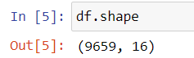
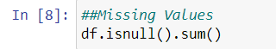
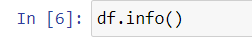
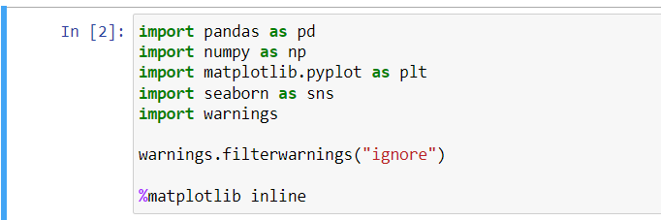
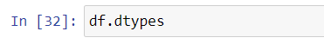
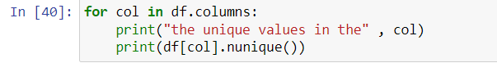
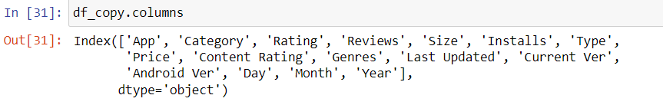
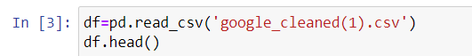
LOADING AND UNDERSTANDING DATA
The Data used for the project is Google Play Store Apps. The data is collected from Kaggle online community platform. The link is listed below :
Google Play Store Apps : Google Play Store Apps (kaggle.com)
TOOLS USED: ▪ Microsoft Excel ▪ Python ▪ Power BI
Importing necessary modules in Understanding dataset
python

Slide 5
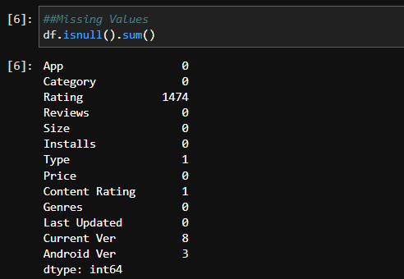
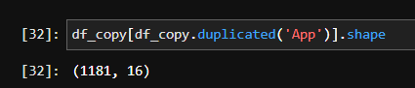
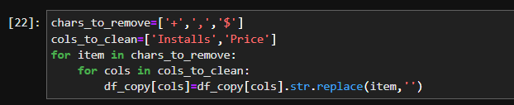
DATA VALIDATION AND PREPROCESSING
The original data was copied, in which all the data cleaning operations are done.
There were around 16 apps, where duplicate data were present.There were 1181 duplicate rows removed.
Few Data types of the columns were changed such as the reviews columns which was an object was changed to integer.
The datatypes in the size column were changed.
The missing values was handled.
The datatypes in the installs and the price column was changed.

Slide 6

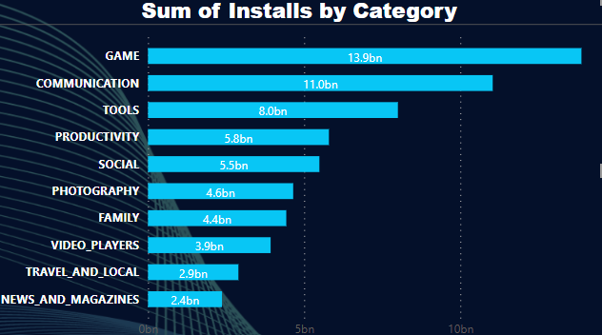
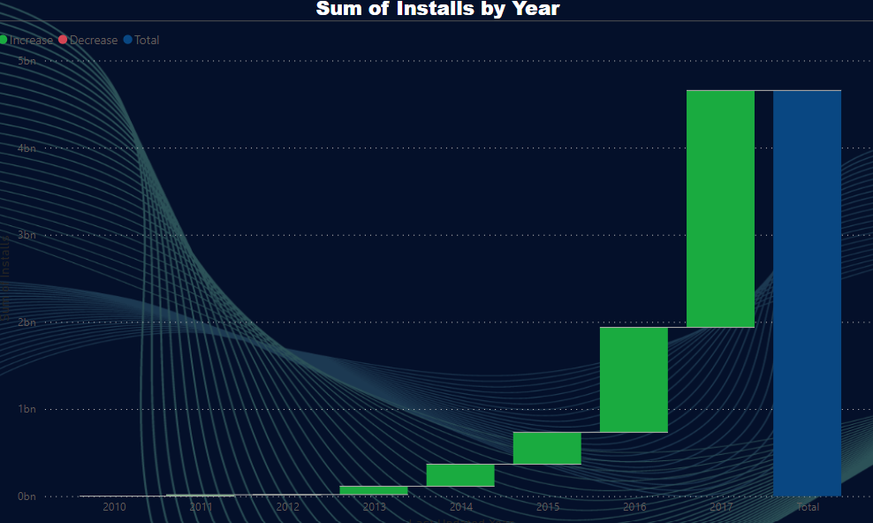
EDA and VISUALIZATION
Game ,Comm. And Tools alone are contributing 53 %
Popularity of play store
How user engagement increased over years

Slide 7
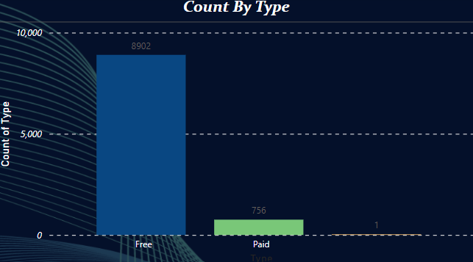
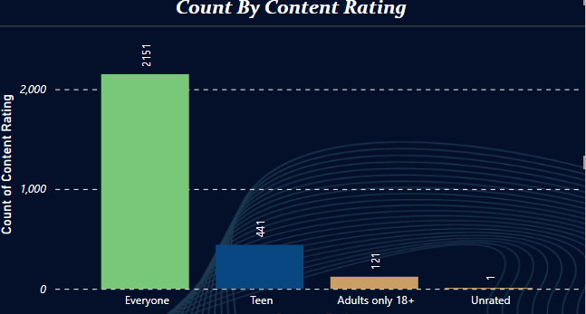
EDA and VISUALIZATION
Customers preference of Free Apps as shown in the above chart
Bar chart of content rating

Slide 8
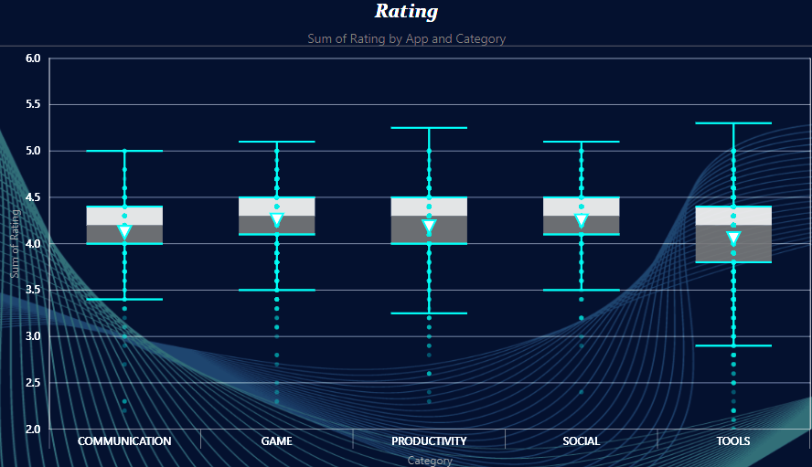
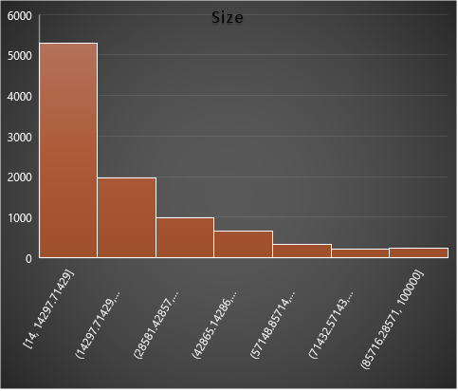
EDA and VISUALIZATION
Box plot of top 5 categories of Apps
Histogram plot of size of Apps

Slide 9

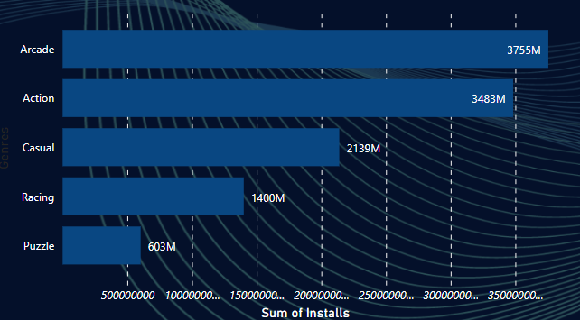
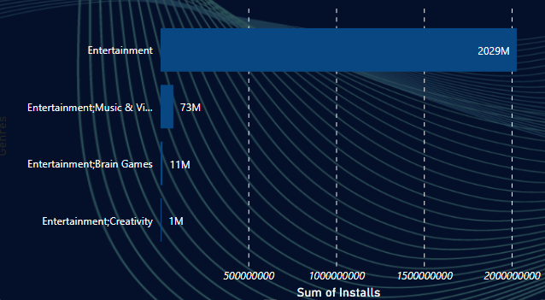
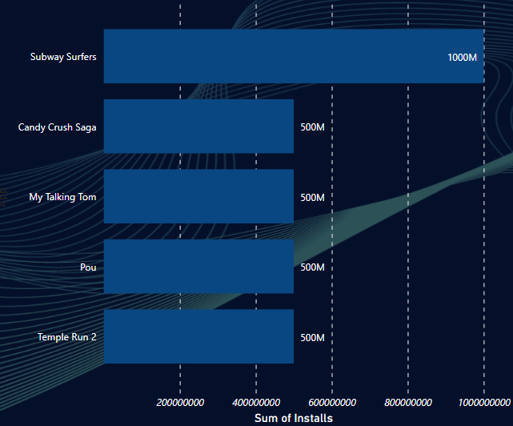
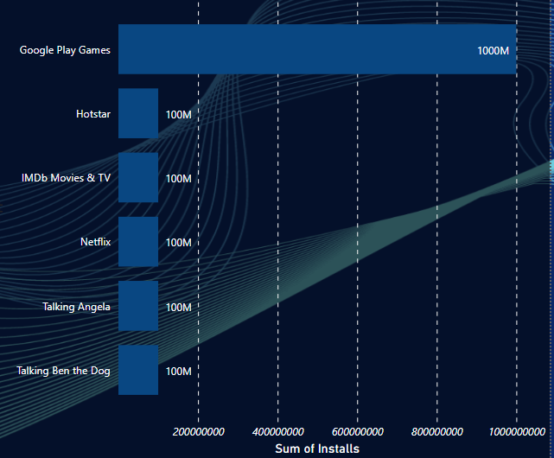
Analysis of Genres and Apps within a category
GAMES
ENTERTAINMENT

Slide 10
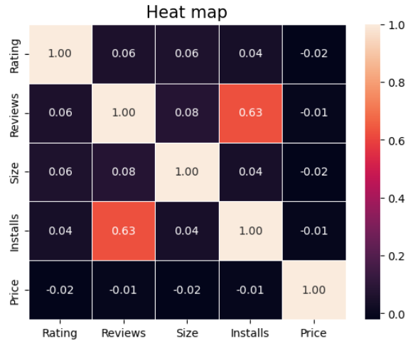
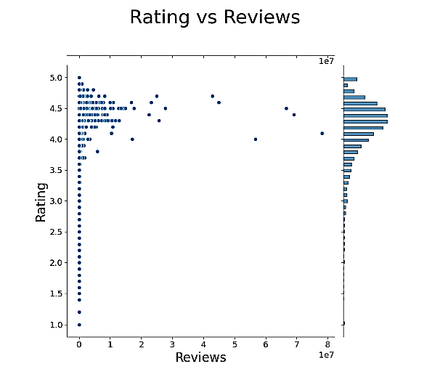
Bivariate Analysis
Correlation matrix
Reviews and sum of installs –moderate positive correlation

Slide 11
Conclusions
Aspects that the developer should research before proceeding with the app development
1-Free apps have large customer base - 20 free apps that have been installed over a billion times.
2-Game category has the highest number of installs.
3-Communication Category has the highest average app installs.
4-In Finance Category the paid apps have the highest average installation fee.
5-Facebook is the most popular app in the Play Store based on the number of reviews.
6-The apps whose size is greater than 90 MB has the highest number of average user reviews, i.e., they are more popular than the rest.

